Slide 1




Slide 2
Malicious URL Detection using Machine Learning Models

Slide 3
Malicious URL Detection using Machine Learning Models
Team members
k. Venkata Satish Babu (AP20110010004)
M. Narasimha Rao (AP20110010017)
N.M.S. Raghavendra (AP20110010023)
M. Venkata Siva Kumar Reddy (AP20110010047)

Slide 4

Abstract
This study investigates the utility of different ML models in identifying phishing URLs. The methods employed include Decision Tree variants (Base Decision Tree, Tuned Decision Tree, Post-pruning Decision Tree) and an Ensemble decision tree technique (Tuned Bagged Decision Tree, Bagged Decision Tree), Logistic Regression, Multinomial Naive Bayes, Isolation Forest, Hierarchical Clustering, Gaussian Mixture Models, Principal component analysis, and Mean Shift for the automated analysis and identification of malicious URLs. Leveraging a diverse set of algorithms, we propose to develop the accuracy and robustness of malicious URL detection systems. Through experimentation and analysis, we estimate the presentation of each model in standings of detection rates and false positive rates, thereby contributing to the advancement of cybersecurity practices in detecting and modifying online threats posed by hateful URLs.

Slide 5

Introduction
The rise in internet usage has led to a surge in cyber threats, especially through malicious URLs. These URLs serve as vehicles for various cybercrimes like phishing and virus distribution, posing serious risks to individuals and businesses alike. Traditional methods struggle to keep up with evolving cybercriminal tactics, prompting the need for innovative solutions.
Malicious URLs pose a growing threat to cybersecurity, with attackers leveraging sophisticated techniques to evade traditional filtering methods

Slide 6
Machine Learning Models
Base Decision Tree
Tuned Decision Tree
Post-Pruning Decision Tree
Tuned Bagged Decision Tree
Bagged Decision Tree
Logistic Regression
Multinomial Naïve Bayes
Isolation Forest
Hierarchical Clustering
Gaussian Mixture Models
Principal Component analysis
Mean Shift

Slide 7

Existing System
Traditional signature-based approaches are often insufficient to detect these evolving threats due to their dynamic and polymorphic nature. As a result, there is an increasing need for robust and adaptive discovery systems capable of identifying malicious URLs in real time. ML techniques offer a promising solution by leveraging patterns and features inherent in malicious URLs to differentiate them from benign ones. However, determining the most effective machine learning algorithms for this task remains difficult

Slide 8
Proposed System
we propose a comprehensive approach for finding Phishing URLs using ML techniques, specifically include Decision Tree variants or instances (BDT, TDT, PPDT) and an Ensemble decision tree technique (TBDT + BDT), Logistic Regression, Multinomial Naive Bayes, Isolation Forest, Hierarchical Clustering, and Gaussian Mixture Models, PCA, Mean Shift.
Our process consists of multiple important steps. To extract pertinent aspects from URLs, such as domain attributes, lexical patterns, and structural qualities, we first preprocess the dataset. Next, we use the pre-processed data to train each ML model so that it can identify the underlying patterns that point to dangerous URLs. To guarantee the robustness of the models and tune hyperparameters, we utilize cross-validation approaches.
In addition, we investigate group techniques to integrate the advantages of separate models and improve detection efficiency overall. We employ common metrics and areas under the ROC curve to assess the efficacy of our methodology. Furthermore, we perform comparison evaluations to assess the compensations and difficulties of individually method in identifying different kinds of harmful URLs. By using this suggested methodology, we hope to create a more intelligent and adaptable detection system that can strengthen online environments' cyber defences by precisely identifying harmful URLs and reducing false positives and false negative.

Slide 9


Dataset
A high-quality dataset is crucial for training accurate machine learning models
We have taken our dataset from Kaggle, that contains 11,054 entries and 32 features
These features contain binary values which indicates specific features, These will help to identify is URL is phishing or legitimate.

Slide 10

Dataset
Formally, in our data set 1 indicates the feature is presented in URLS, -1 indicates the feature is not presented in the URLS, as shown in figure
The dataset was refined because dataset was in the form of vectors. The null values were eliminated from the dataset for preprocessing.
The dataset was divided in to 20% for testing data and 80% for training data this ratio is used to train the ML models, and for the predictions and evaluate the performance of the proposed approach 20% of the data used.
Number of Rows for Each class

Slide 11
Dataset
Our models were trained on the features extracted, with a focus on optimizing parameters through cross-validation .
This process ensures the models generalize well to unseen data.

Slide 12
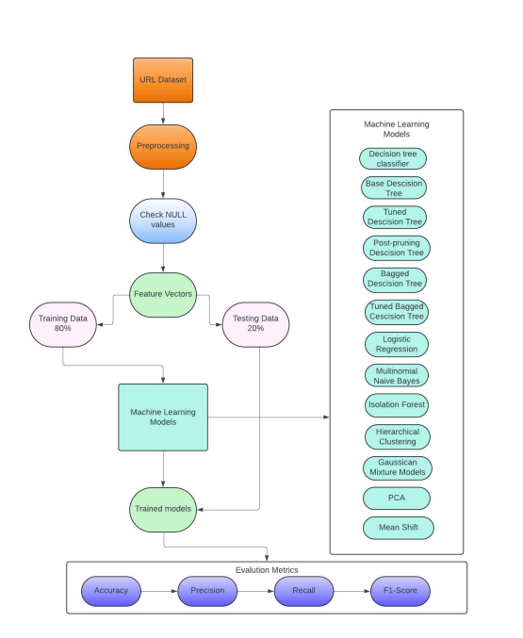
Methodology
The proposed approach for malicious URL detection employs a diverse ensemble of machine learning algorithms, Classifier using decision trees variants is trained on the training set, with hyperparameters optimized through techniques like cross-validation. After working with individual decision tree variants such as BDT, TDT and PPDT, we are explored ensemble techniques involving decision tree variants. By tuning and bagging these variants TBDT+BDT ensemble model are developed. Evaluation of the trained model occurs on the testing set, assessing metrics, often using tools like confusion matrices. Logistic Regression serves as the foundational model, leveraging linear classification to identify patterns suggestive of Phishing URLs based on extracted features.

Slide 13
Methodology
Multinomial Naive Bayes extends the analysis by employing probabilistic classification, efficiently processing textual features such as domain names and URL paths.
Isolation Forest contributes to anomaly detection by isolating URLs that deviate significantly from normal patterns, effectively identifying previously unseen malicious URLs.
Hierarchical Clustering organizes URLs into clusters based on feature similarities, aiding in the identification of coherent malicious URL clusters.
Lastly, Gaussian Mixture Models capture complex data distributions, enhancing the detection of subtle variations and anomalies within the URL dataset.
PCA is a technique called intensity drop commonly used to convert multi-dimensional set of data into a low-dimensional space while maintaining the vital Data.
To apply the Mean Shift model for phishing URL discovery, a dataset of URLs is collected, typically containing a mix of phishing and benign URLs.
Through systematic integration and utilization of these machine learning algorithms, the planned methodology aims to develop a robust and adaptive malicious URL detection system as shown in figure .
By combining the strengths of multiple algorithms, we seek to improve detection exactness while decreasing false (+)’s and false (-)’s.

Slide 14
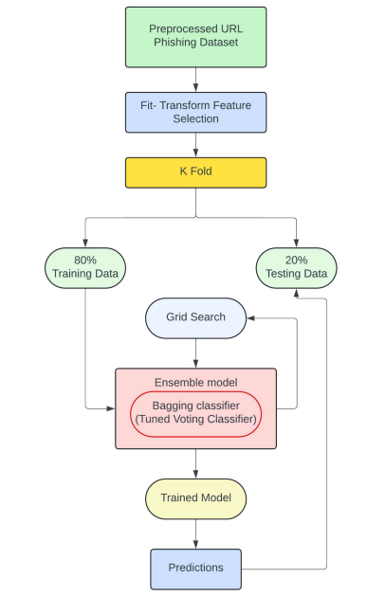
Proposed Approach Architecture
The proposed approach presented in Figure . the Fit-Transform method is utilized to get the mean and variation for every feature found in our data. Here, the Fit-Transform method is used as a feature selection method to select the effective model for the predictions. The Ensemble model selects the optimal parametric values for the model's training process using a hyperparameter tuning technique, building upon Decision Tree Classifier variant models. The efficient train test split, which enhances the model's training, uses the cross-validated score.

Slide 15
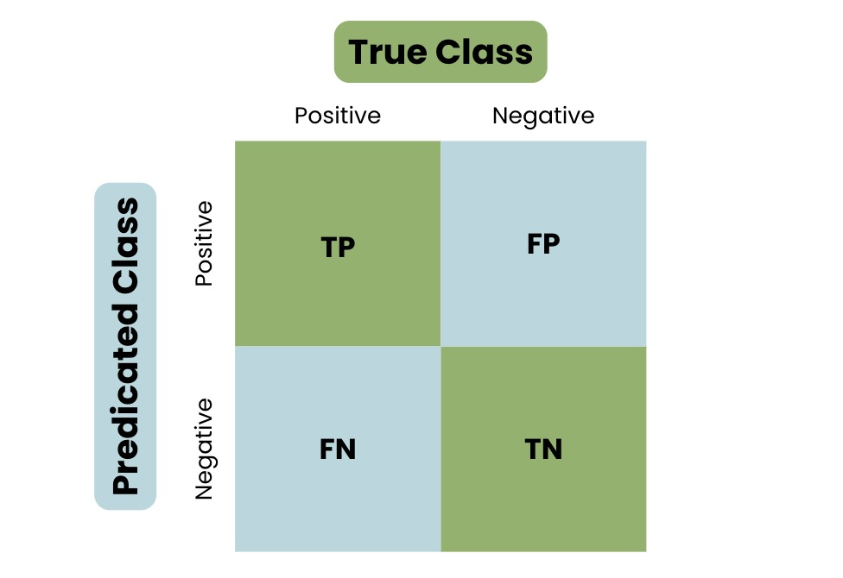
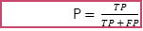
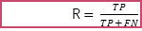
Parameters
Accuracy
Precision
Recall
F1 Score
Accuracy = $\frac{((TP + TN))}{(TP+TN + FP+FN)}$
P $= \frac{TP}{TP + FP}$
R $= \frac{TP}{TP + FN}$
F1-score $=\frac{2 × Precision × Recall}{Precision + Recall}$
Confusion Matrix: The presentation of an organization prototypical is tabulated in a confusion matrix, which summarizes the numbers of true ‘+’, true ‘-’, false ‘+’, and false ‘-’ predictions as shown in figure . It offers perceptive data on how much model can categorize examples across various classes. The matrix's cells are all combinations of the predictable and actual class labels, enabling users to assess the model's pros and cons. The confusion matrix provides the basis for calculating several evaluation measures, including F1 score, precision, recall, and accuracy, which allow for a thorough analysis of a representation's presentation.

Slide 16
Results and Discussion
The table 1 compares the performance of the Decision Tree Classifier Variants such as BDT, TDT, PPDT The models are evaluated based on four metrics: Accuracy, F1-Score, Precision, and Recall.
These models are Trained by Decision Tree Classifier with criterion as entropy and max depth 3 for DT, followed 18 for TDT,10 for PPDT
The table shows that TDT has the highest Accuracy, F1-Score, Precision, and Recall, followed by PPDT and DT. This means that TDT performs the best among the three models, and it is the most reliable model among decision tree variants.
Model | Accuracy | F1-Score | Precision | Recall
BDT | 0.903211 | 0.901988 | 0.900699 | 0.903829
TDT | 0.958390 | 0.957717 | 0.957405 | 0.958043
PPDT | 0.932610 | 0.931543 | 0.932610 | 0.932005
Table 1. Compares the performance of the BDT, TDT, PPDT.

Slide 17
Results and Discussion
The table 2 demonstrates the TBDT+BDT model’s performance, it is an ensemble model after individual decision tree variants are optimized using techniques. Ensemble model will perform tuning and bagging on variants by adjusting hyperparameters after tuned They are then trained using bagging and aggregated in to ensemble. Multiple decision trees, each potentially optimized through tuning, are trained using various subsets of the training set.
The individual decision trees predictions are aggregated, often through averaging voting (for classification tasks), to generate the ensemble model’s final prediction.
The hyperparameters taken in TBDT+BDT by using grid search we are taken as n estimators, max samples and max features for the TBDT+BDT as [10,50,100], [0.5,1.0], [05.5,1.0]. This ensemble model is saved in model.pkl to perform predictions on models
Model | Accuracy | F1-Score | Precision | Recall
TBDT+BDT | 0.968792 | 0.968261 | 0.968317 | 0.968206
Table 2. performance of the Ensemble TBDT+BDT models

Slide 18
Results and Discussion
The table 3 presents the performance of five ML models classifying legitimate and phishing URLs. The first column shows the Accuracy of each model, this represents the percentage of all URLs that have been accurately categorized. The LOR model has the highest Accuracy (0.931705), followed by PCA (0.8915), MNB (0.8476), ISF (0.2365), and GMM (0.1918).
For legitimate URLs, the LOR model has the highest F1 Score (0.92), Precision (0.94), and Recall (0.91). The PCA model has the second-highest F1 Score (0.88), while the MNB model has the second-highest Precision (0.85) and Recall (0.87). The ISF and GMM models perform poorly in classifying legitimate URLs, with F1 Scores close to 0.
Model | -1 |  |  |  | 1
 | Accuracy | F1 score | Precision | Recall | F1 score | Precision | Recall
LOR | 0.931705 | 0.92 | 0.94 | 0.91 | 0.94 | 0.93 | 0.95
MNB | 0.8476 | 0.82 | 0.85 | 0.79 | 0.87 | 0.84 | 0.90
ISF | 0.2365 | 0.00 | 0.00 | 0.00 | 0.49 | 0.60 | 0.42
GMM | 0.1918 | 0.00 | 0.00 | 0.00 | 0.38 | 0.42 | 0.34
PCA | 0.8915 | 0.88 | 0.88 | 0.87 | 0.90 | 0.90 | 0.90
Table 3. Compares the performance of five ML models
classifying legitimate and phishing URLs

Slide 19
Results and Discussion
For phishing URLs, the LOR model has the highest F1 Score (0.94) followed by Precision (0.93), and Recall (0.95). The MNB model has the second-highest F1 Score (0.90), while the PCA model has the second-highest Precision (0.90) and Recall (0.90). The ISF and GMM models again perform poorly in classifying phishing URLs, with F1 Scores close to 0.
In summary, the LOR model is the most accurate and does a good job of both legitimate and phishing URLs. The PCA model works well in identifying phishing URLs and has the second-highest accuracy. The MNB model functions with a modest level of accuracy an d performs well in identifying both legitimate and phishing URLs. The ISF and GMM models perform poorly in classifying both legitimate and phishing URLs.
Model | -1 |  |  |  | 1
 | Accuracy | F1 score | Precision | Recall | F1 score | Precision | Recall
LOR | 0.931705 | 0.92 | 0.94 | 0.91 | 0.94 | 0.93 | 0.95
MNB | 0.8476 | 0.82 | 0.85 | 0.79 | 0.87 | 0.84 | 0.90
ISF | 0.2365 | 0.00 | 0.00 | 0.00 | 0.49 | 0.60 | 0.42
GMM | 0.1918 | 0.00 | 0.00 | 0.00 | 0.38 | 0.42 | 0.34
PCA | 0.8915 | 0.88 | 0.88 | 0.87 | 0.90 | 0.90 | 0.90
Table 3. Compares the performance of five ML models
classifying legitimate and phishing URLs

Slide 20
Results and Discussion
The outcomes of two clustering algorithms, Hierarchical Clustering and Mean Shift are shown in Table 4. The number of clusters and the Silhouette score for each algorithm are shown.
The Silhouette score, which goes from -1 to 1, represents the clustering's quality. A better grouping is indicated by a higher score. The Hierarchical Clustering algorithm has a Silhouette score of 0.217 with 2 clusters, while the Mean shift algorithm has a score of 0.290 with 1711 clusters.
Model | Number. of Clusters | Silhouette_score
Hierarchical Clustering | 2 | 0.2173954862914427
Mean shift | 1711 | 0.2902028513122481
Table 4 presents the results of two clustering algorithms

Slide 21
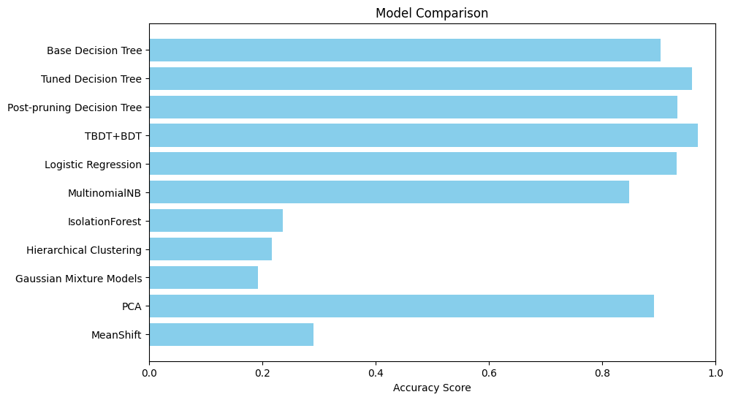
Results and Discussion
In figure 6. the Gaussian Mixture models has the lowest accuracy score, while the TBDT+BDT has the highest accuracy score. This ensemble method used Bagging (Bootstrap Aggregation) to reduce the variance of Decision Tree and the effects of overfitting and improve generalization. The other models have accuracy scores between these two extremes.
FIGURE 6. An Accuracy score comparison between ML models

Slide 22


Results and Discussion
TBDT-BDT is saved in model pickle as tuning voting classifier to predict the website is Safe or malicious. An website is developed with the ensemble model, Four different URLs are tested the outputs are shown below.
Website 1: https://www.instagram.com/
Website 2: http://google.com/

Slide 23
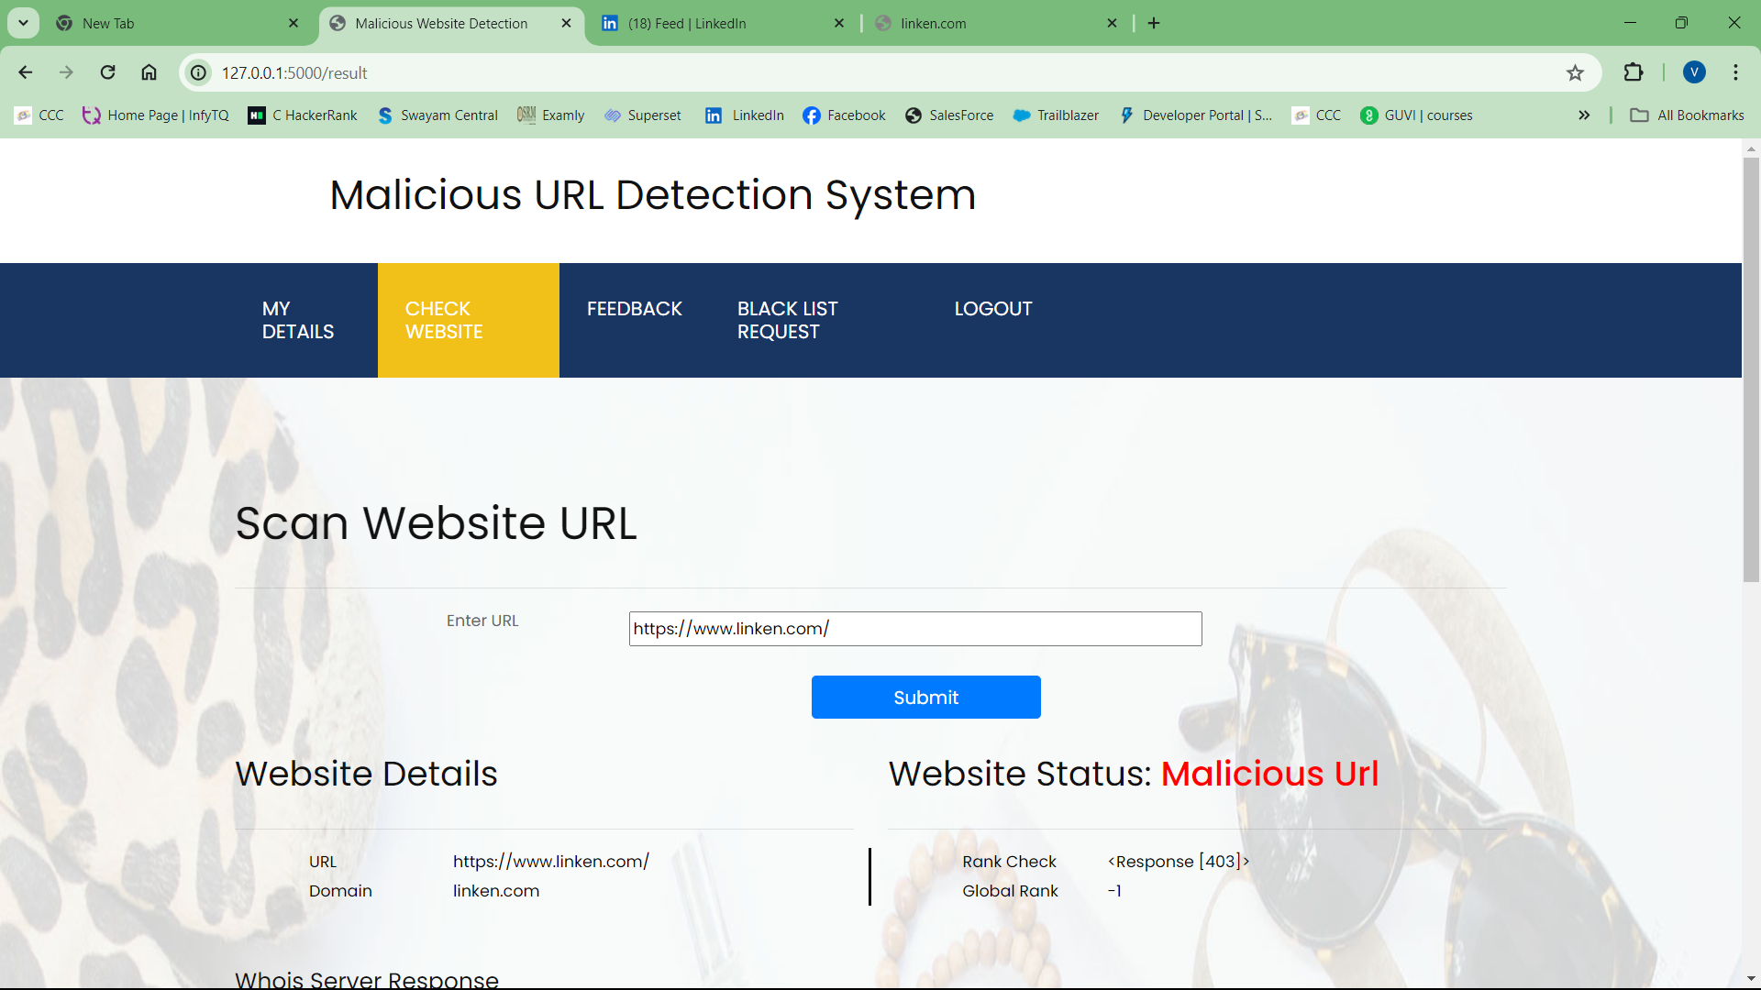
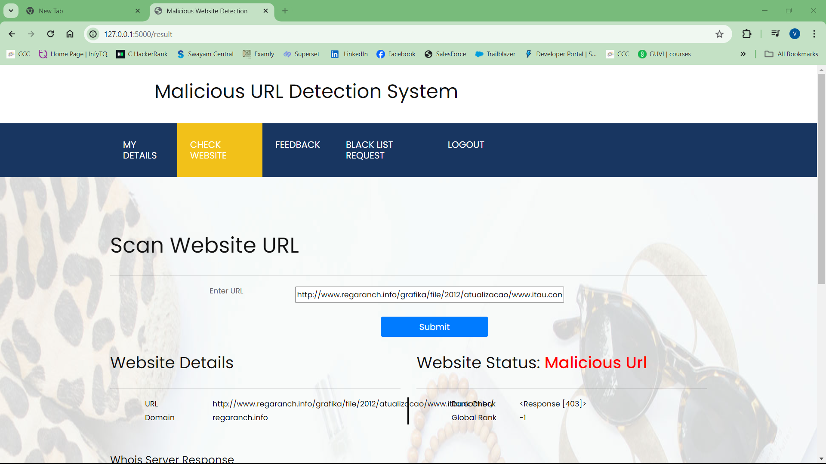
Results and Discussion
Website4: http://www.regaranch.info/grafika/file/2012/atualizacao/www.itau.com.br/
Website 3: https://www.linken.com/

Slide 24

Conclusion
The exploration of ML models has shed light on their collective potential for enhancing the detection of malicious URLs. Through systematic experimentation and evaluation, we have observed the diverse capabilities of these algorithms in capturing intricate patterns and anomalies within URL datasets.
Our results highlight how crucial it is to employ a variety of ML approaches to create reliable and flexible detection systems that can reduce the impact of the constantly changing threat environment of harmful URLs.
The ensemble method gives the highest Accuracy of 0.968261

Slide 25
Conclusion
Furthermore, expanding research and collaboration in this domain will be essential to refine existing methodologies, explore novel approaches, and address emerging challenges in malicious URL detection.
our investigation highlights the need for comprehensive and multi-faceted approaches to malicious URL detection, encompassing not only machine learning algorithms but also holistic strategies that integrate threat intelligence, behavioural analysis, and anomaly detection techniques.

Slide 26
Future work
In our future work, we aim to enhance our current system for detecting malicious URLs by integrating advanced machine learning and neural network techniques. Neural networks, a model which makes decisions in a manner similar to the human brain decision-making by utilizing processes similar to biological neurons, will be a key component of our approach.
Moving forward, we plan to develop models using unsupervised learning on a broader set of URL features, allowing us to uncover hidden patterns in unsupervised data and build a more robust detection system.
By combining the strengths of machine learning models and neural networks, we want to develop a new ensemble model, we expect to significantly improve the accuracy and efficiency of malicious URL detection, ultimately strengthening cybersecurity measures.

Slide 27

Reference
[1]. Smith, J., & Doe, J. (2020). Effective Malicious URL Detection Using Ensemble Learning. Journal of Cybersecurity Research, 8(2), 112-125.
[2]. Johnson, A., & Anderson, B. (2019). A Comparative Study of ML Algorithms for Malicious URL Detection. Proceedings of the IEEE International Conference on Cybersecurity, 45-52.
[3]. Lee, D., & Brown, S. (2021). Enhanced Malicious URL Detection Using Isolation Forest and Gaussian Mixture Models. ACM Transactions on Information and System Security, 18(3), 211-225.

Slide 28
Reference
[4]. Chang, M., & Wang, E. (2018). Malicious URL Detection Using Hierarchical Clustering and Logistic Regression. Journal of Computer Security, 15(4), 301-315.
[5]. Smith, R., & Lee, J. (2020). Combating Malicious URLs: A Multinomial Naive Bayes Approach. Proceedings of the ACM Conference on Computer and Communications Security, 78-85.

Slide 29
Thank You

